Slide 1
MODULE : 11

Slide 2
Ex 6.2 - 7
Prove that a line drawn through midpoint of one side of a
triangle parallel to another side bisects the third side.
Given :
In ΔABC,
A
M is midpoint of side AB
MN || BC
Prove that :
AN = CN
M
N
Proof :
In ΔABC,
MN || BC
... [given]
B
C
AM
AN
=
...(i)
... [by basic proportionality theorem]
MB
NC
AM
=
1
...(ii)
... [M is midpoint of side AB]
MB
AN
=
1
.... from (i) and (ii)
NC
AN = NC

Slide 3
Ex 6.2 - 8
Prove that the line joining the midpoints of any two
side of a triangle is parallel to the third side.
A
Given :
In ΔABC,
M & N are midpoints of sides AB & AC resp.
To prove :
MN || BC
M
N
Proof :
In ΔABC,
AM
,
=
1
...(i)
[M is midpoint of side AB]
MB
B
C
AN
=
1
...(ii)
[N is midpoint of side AC]
NC
AM
AN
... from (i) and (ii)
=
MB
NC
...[by converse of basic
proportionality theorem]
MN || BC

Slide 4
MODULE : 12

Slide 5
Solved Example :
PS
PT
=
and ∠PST = ∠PRQ. Prove that PQR is an isosceles triangle.
SQ
TR
P
PS
PT
Sol:
=
SQ
TR
∴
ST || QR
(Basic proportionality theorem)
S
T
∴
∠PST
=
∠PQR
…(1)
(Corresponding angles)
But
∠PST
=
∠PRQ
…(2)
Q
R
∴
∠PRQ
=
∠PQR
[From (1) and (2)]
and
PQ
=
PR
(Sides opposite the equal angles)
i.e., PQR is an isosceles triangle.

Slide 6
MODULE : 13

Slide 7
Intercept
A
seg AB is the intercept
l
m
B
n
C
x
In the fig.,
seg AB is the intercept formed
on transversal x by lines l and m.

Slide 8
The ratio of the intercepts made on a transversal by three parallel
lines is equal to the ratio of the corresponding intercepts made
on any other transversal by the same parallel lines.
Intercepts on y
PQ
EF
x
y
EF
FG
EG
=
QR
FG
P
E
l
QR
FG
Intercepts on x
=
Q
F
PR
EG
PQ
QR
PR
m
PQ
EF
R
G
=
n
PR
EG

Slide 9
Solved Example :
ABCD is a trapezium with AB || DC. E and F are points on non-parallel
sides AD and BC respectively such that EF is parallel to AB .
AE
BF
Show that
=
ED
FC
A
B
Sol:
AB || DC
and EF || AB
∴
EF || DC
(Lines parallel to the same line are parallel to each other)
E
G
F
Join AC intersecting EF at point G
In ΔADC,
EG || DC
(As EF || DC)
D
C
AE
AG
∴
=
…(1) [By Basic Proportionality Theorem]
ED
GC
In ΔCAB,
FG || AB
∴
CG
CF
=
…(2)
AG
BF

Slide 10
Solved Example :
ABCD is a trapezium with AB || DC. E and F are points on non-parallel
sides AD and BC respectively such that EF is parallel to AB .
AE
BF
A
B
Show that
=
ED
FC
Sol:
AG
BF
…(3)
G
i.e.,
=
E
F
GC
FC
AE
BF
=
[From (1) and (3)]
ED
FC
D
C
CG
CF
=
…(2)
AG
BF
AE
AG
=
…(1)
ED
GC

Slide 11
MODULE : 14

Slide 12
CONGRUENT FIGURES
Figures having same shape and same size
are called CONGRUENT FIGURES

Slide 13

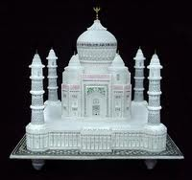
SIMILAR OBJECTS

Slide 14


SIMILAR OBJECTS

Slide 15

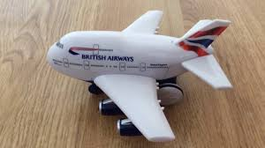
SIMILAR OBJECTS
Figures whose SHAPE is SAME and size
may or may not be same are similar.

Slide 16
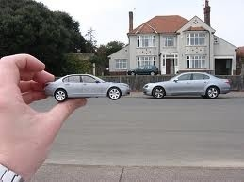
SIMILAR OBJECTS
Figures whose shape is same and size may or may not be same are similar.

Slide 17

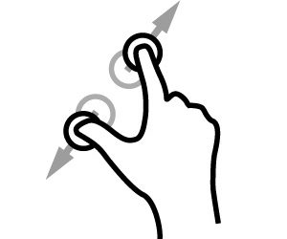
If
∼
Zoom 2×
ΔABC
is similar to
ΔPRQ
then,
∠A ≅ ∠P
P
∠B ≅ ∠R
∠C ≅ ∠Q
A
A
30°
Corresponding angles of similar triangles are CONGRUENT.
30°
8.5 cm
10 cm
17 cm
20 cm
B
60°
C
B
C
5 cm
AB
BC
AC
60°
=
=
R
10 cm
Q
PR
QR
PQ
Corresponding sides of similar triangles are in PROPORTION
AB
8.5
1
BC
5
1
AC
10
1
=
=
=
=
=
=
PR
17
2
QR
10
2
PQ
20
2

Slide 18

ΔABC is similar to ΔPQR
P
A
A
SIDES →
doubled
4 cm
70º
6 cm
70º
ANGLES →
?
8 cm
12 cm
B
80º
30º
5 cm
C
AB
1
BC
1
AC
1
=
=
Q
=
B
C
PQ
QR
80º
30º
R
2
2
PR
2
10 cm
AB
BC
AC
=
=
PQ
QR
PR
Corresponding pairs of similar triangles are in proportion.
∠A = ∠P
, ∠B = ∠Q
, ∠C = ∠R
Corresponding pairs of similar triangles are equal.
Notes:
18

Slide 19
A
P
B
C
Q
R
∼
ΔPQR
A
B
C
P
Q
R
ΔABC
AB
BC
AC
Corresponding sides of similar triangles
=
=
PQ
QR
PR
∠A = ∠P,
∠B = ∠Q,
Corresponding angles of similar triangles
∠C = ∠R
Notes:
19

Slide 20
SIMILAR TRIANGLES
ΔABC
∼
ΔQRP
[Given]
AB
BC
AC
Corresponding sides of similar triangles
∴
=
=
[c.s.s.t.]
QR
PR
PQ
Also,
ÐA @ ÐQ
[c.a.s.t.]
∠B ≅ ∠R
Corresponding angles of similar triangles
ÐC @ ÐP

Slide 21
Thank You

